Slide 1
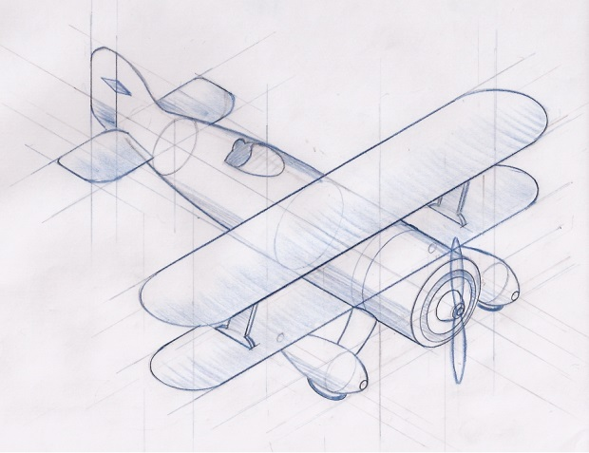
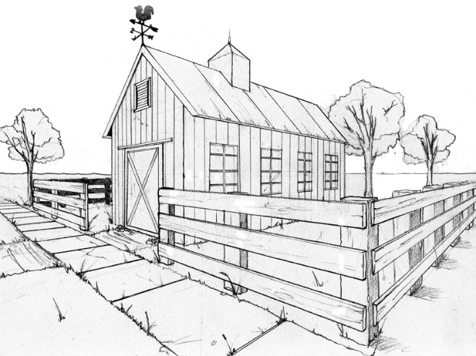
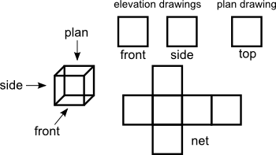
Representing 3D objects in 2D

Slide 2
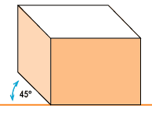
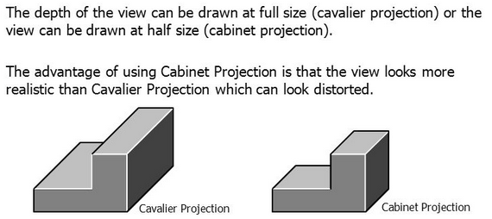
Oblique Views
Oblique projection is a simple type of projection used for producing two-dimensional images of three-dimensional objects
Leading face
Oblique projections have a leading face and lines project back from this face at 45^{O}

Slide 3
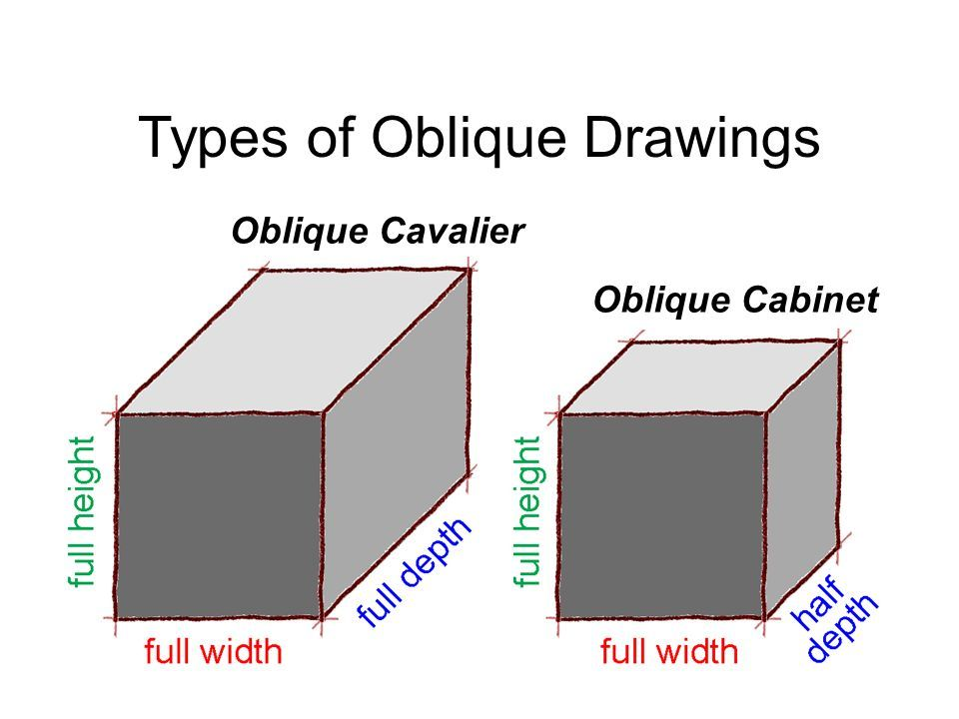

Slide 4
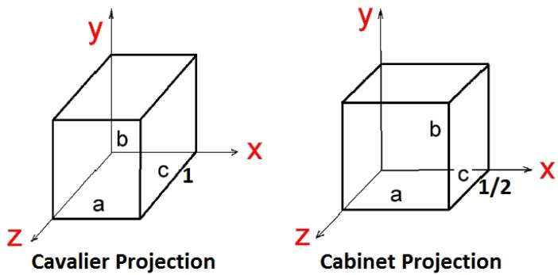
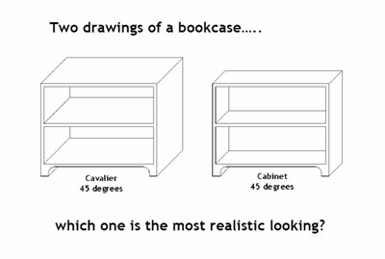

Slide 5
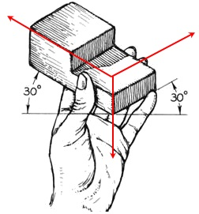
ISOMETRIC DRAWINGS
The object is held with one vertical edge leading, then tilted toward the viewer until the other horizontal edge are at a 30 degree angles.
All three axes are scaled equally at 120 degrees. This is why they are called isometric as “iso” means same and metric means “measure”.
120º
120º
120º

Slide 6
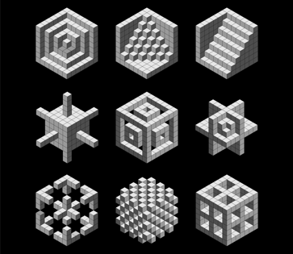

Slide 7
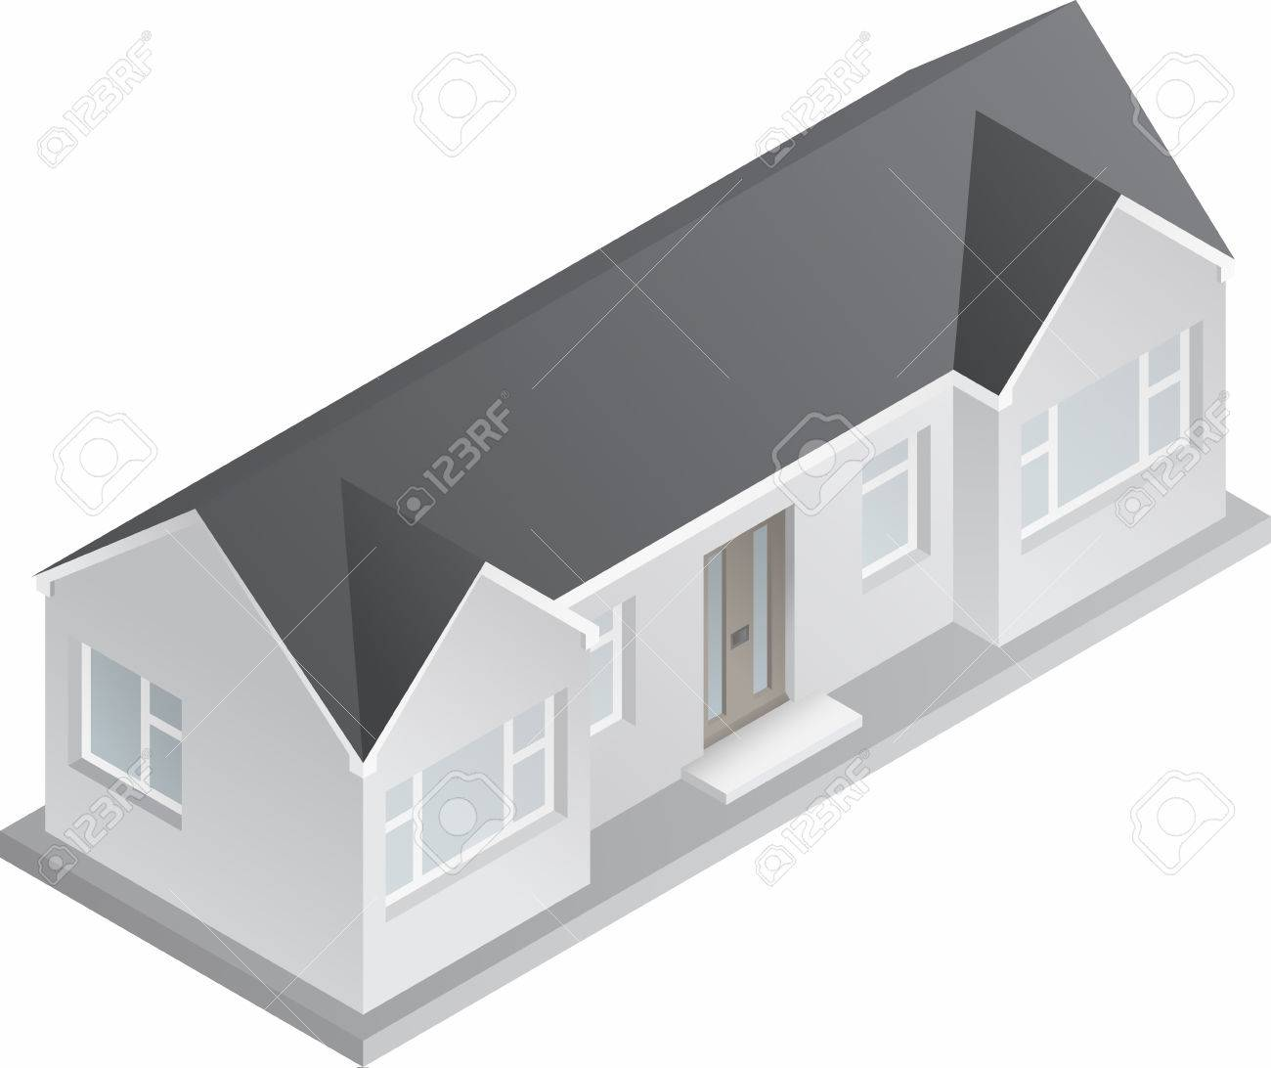
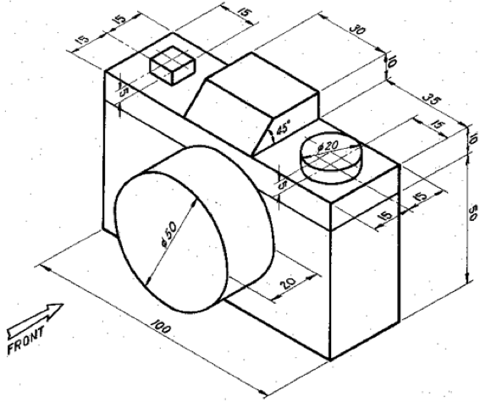
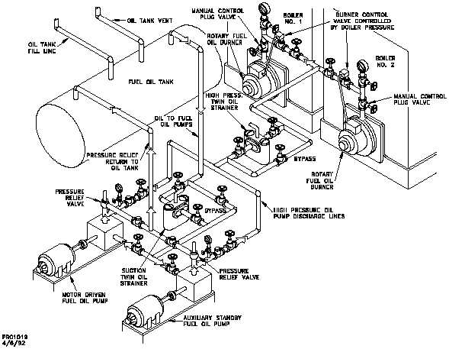

Slide 8
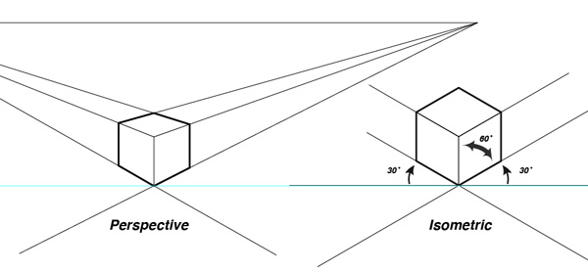
Similar to an isometric diagram is a perspective diagram, in a perspective diagram however, all the lines converge on a point “in the distance”. In Isometric, the lines are always parallel.
We are only looking at isometric drawings for now.

Slide 9
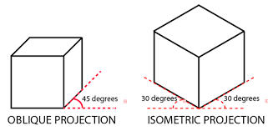
3D shape representations
EQ – How can we represent 3d objects in 2d paper?
An oblique drawing has a leading face, the edges lead back at a 45º slant.
What is an Oblique drawing?
What is an Isometric drawing?
An isometric drawing has a leading edge, the left and right edges lead back at a 30º slant.

Slide 10
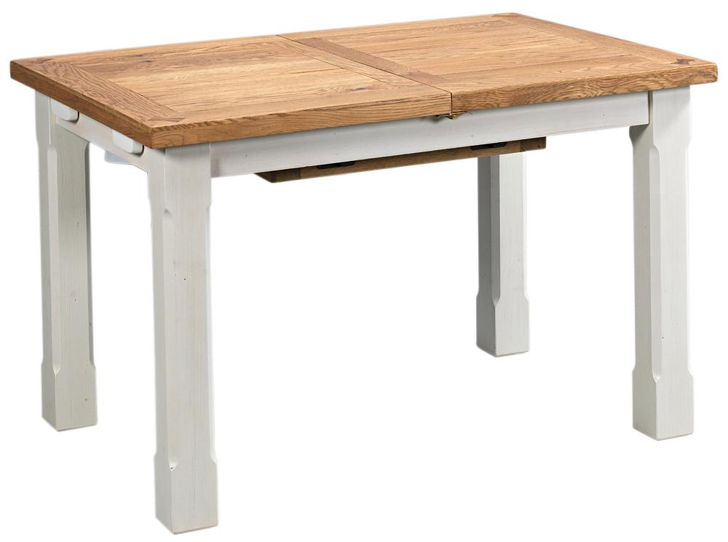
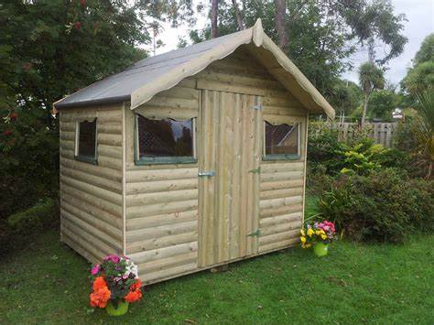
Lets try and draw these in oblique and isometric
A dining table b) a garden shed

Slide 11
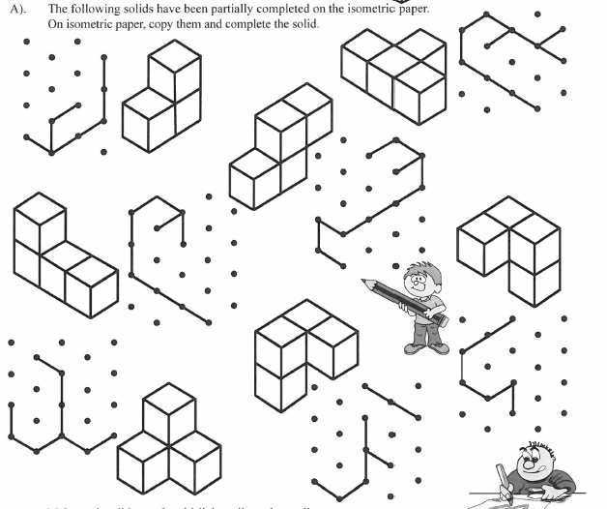

Slide 12
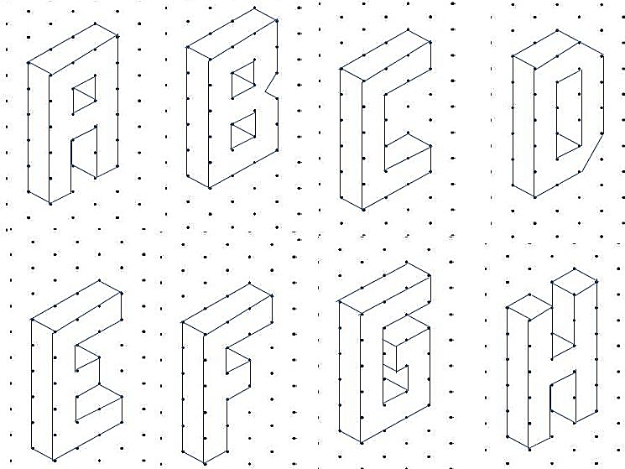
Try and draw your name in Isometric Letters

